Slide 1
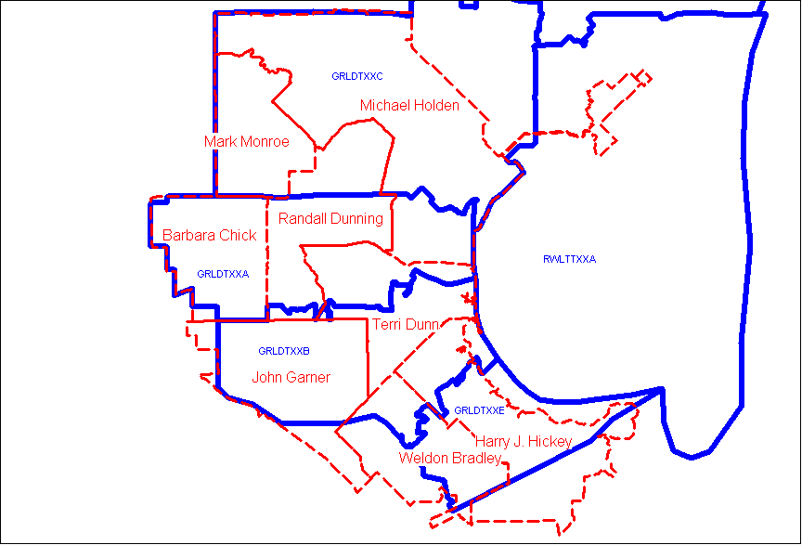
City of Garland Districts and Verizon Wire Centers
North
Main
South
Southeast
By Mike Blasius 12-22-2005

